Slide 1

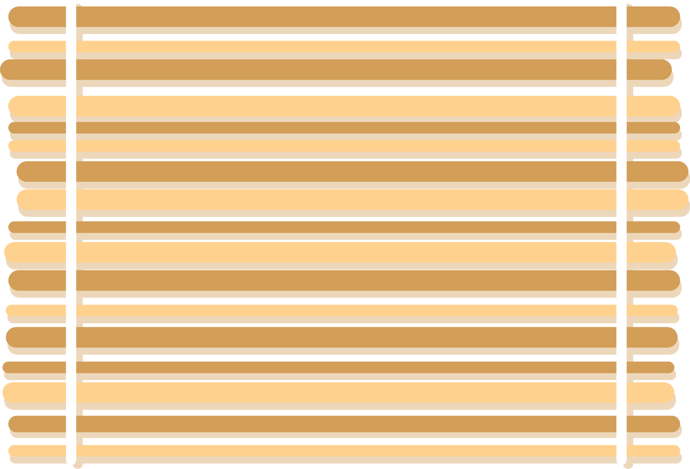







PIZZA
SALES ANALYSIS

Slide 2






This project presents a comprehensive analysis of pizza sales data utilizing Structured Query Language (SQL). It examines key performance indicators, including total orders, revenue, top-selling pizzas, and ordering patterns over time.
The objective is to derive actionable business insights directly from raw relational databases through the application of optimized SQL queries across multiple joined tables.

Slide 3
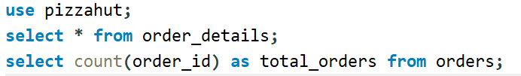
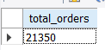

1.RETRIEVE THE TOTAL NUMBER OF ORDERS PLACED.

Slide 4
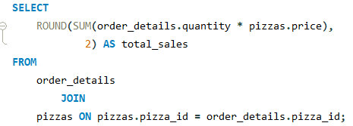
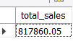
2. CALCULATE THE TOTAL REVENUE GENERATED FROM PIZZA SALES.

Slide 5
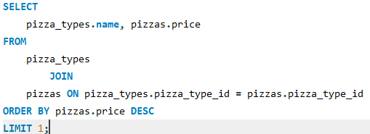
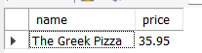
3. IDENTIFY THE HIGHEST-PRICED PIZZA.

Slide 6
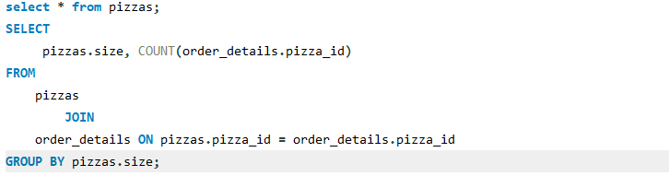
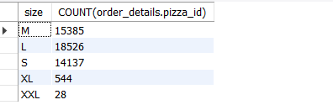
4.IDENTIFY THE MOST COMMON PIZZA SIZE ORDERED.

Slide 7
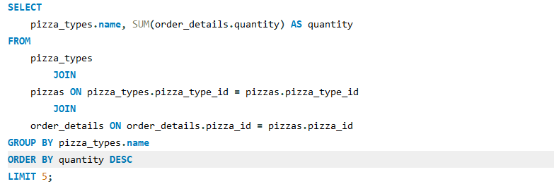
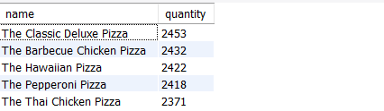
5. LIST THE TOP 5 MOST ORDERED PIZZA TYPES ALONG WITH THEIR QUANTITIES.

Slide 8
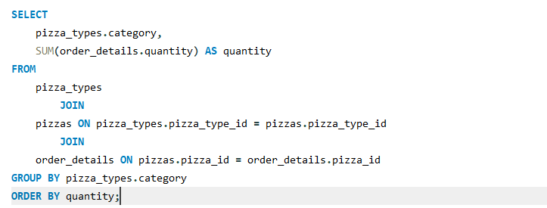
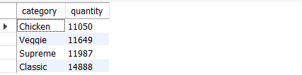
6. JOIN THE NECESSARY TABLES TO FIND THE TOTAL QUANTITY OF EACH PIZZA CATEGORY ORDERED.

Slide 9
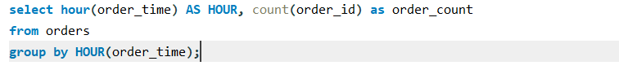
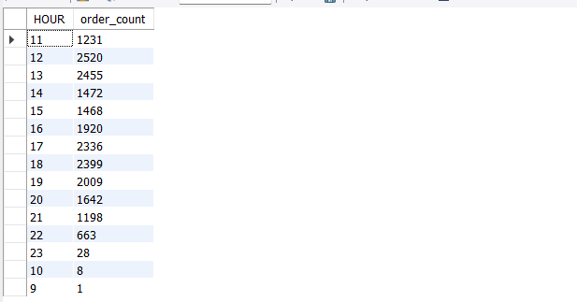
7. DETERMINE THE DISTRIBUTION OF ORDERS BY HOUR OF THE DAY.

Slide 10
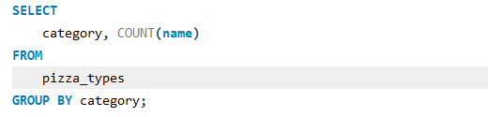
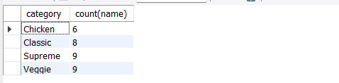
8. JOIN RELEVANT TABLES TO FIND THE CATEGORY-WISE DISTRIBUTION OF PIZZAS.

Slide 11
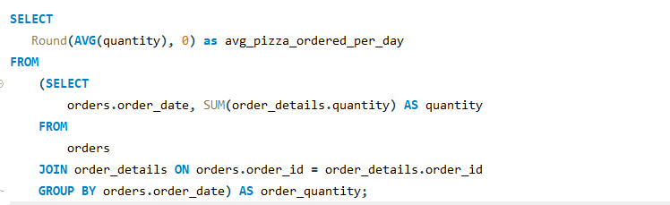
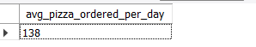
9. GROUP THE ORDERS BY DATE AND CALCULATE THE AVERAGE NUMBER OF PIZZAS ORDERED PER DAY.

Slide 12
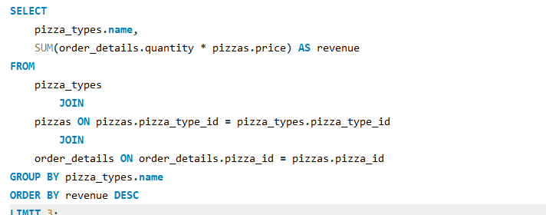
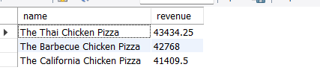
10. DETERMINE THE TOP 3 MOST ORDERED PIZZA TYPES BASED ON REVENUE.

Slide 13
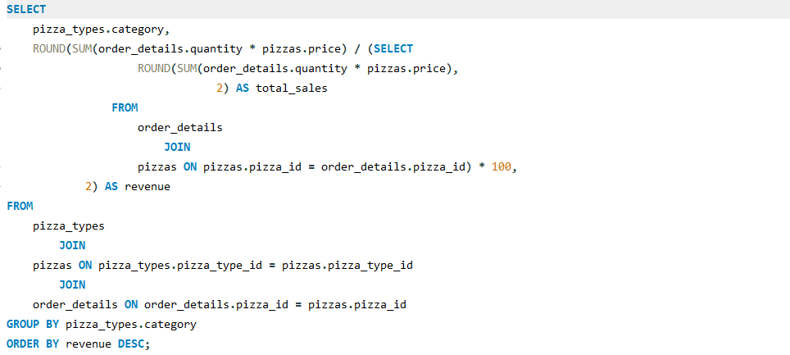
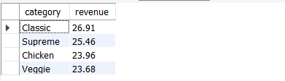
11. CALCULATE THE PERCENTAGE CONTRIBUTION OF EACH PIZZA TYPE TO TOTAL REVENUE.

Slide 14
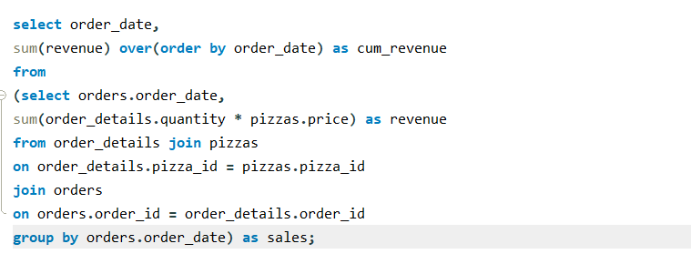
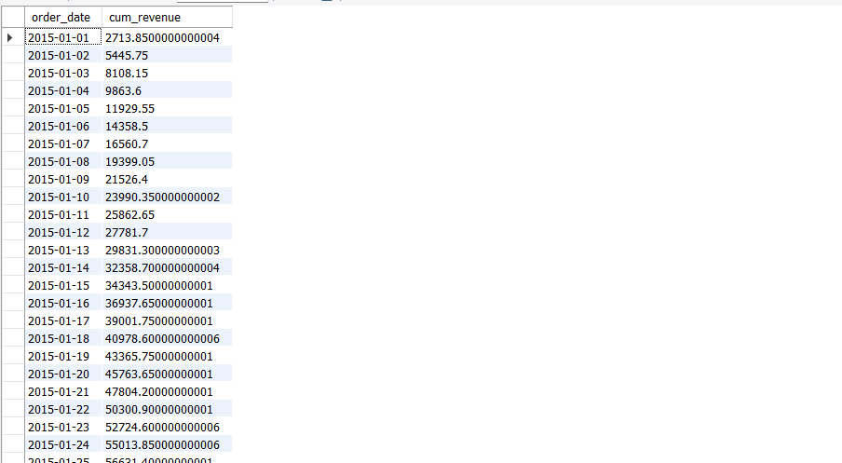
12. ANALYZE THE CUMULATIVE REVENUE GENERATED OVER TIME.

Slide 15
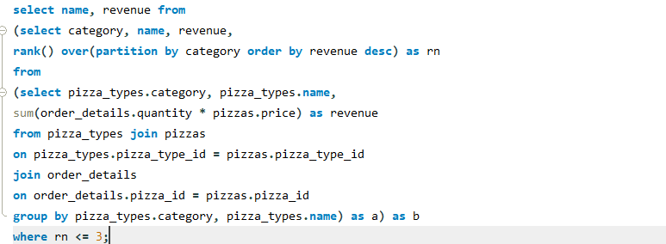
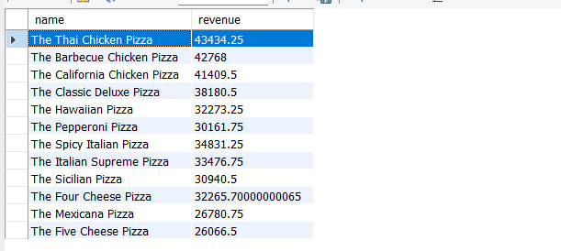
13. DETERMINE THE TOP 3 MOST ORDERED PIZZA TYPES BASED ON REVENUE FOR EACH PIZZA CATEGORY.

